Slide 1
Chapter 8
Transformation

Slide 2
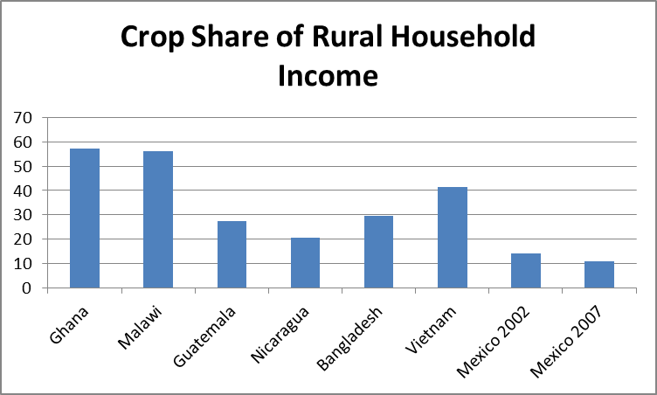
Less Rural, Less Agricultural
On May 23, 2007, the world became more urban than rural
Rural economies are becoming less agricultural
Sources: Winters, P., Davis, B., Carletto, G., Covarrubias, K., Quinones, E., Zezza, A. 2009. "Assets, Activities and Rural Income Generation: Evidence from a Multicountry Analysis." World Development, 37(9), 1435-1452 (Table 2) and tabulation of Mexico National Rural Household Survey (ENHRUM) data.

Slide 3
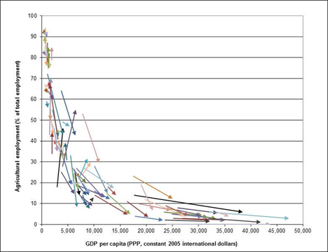
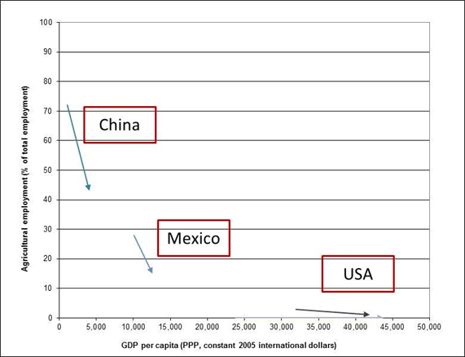
Everyone Is Fleeing the Farm
Income Growth and Ag Labor Shares
Source: Taylor and Lybbert, RebelText: Essentials of Development Economics, 2012

Slide 4
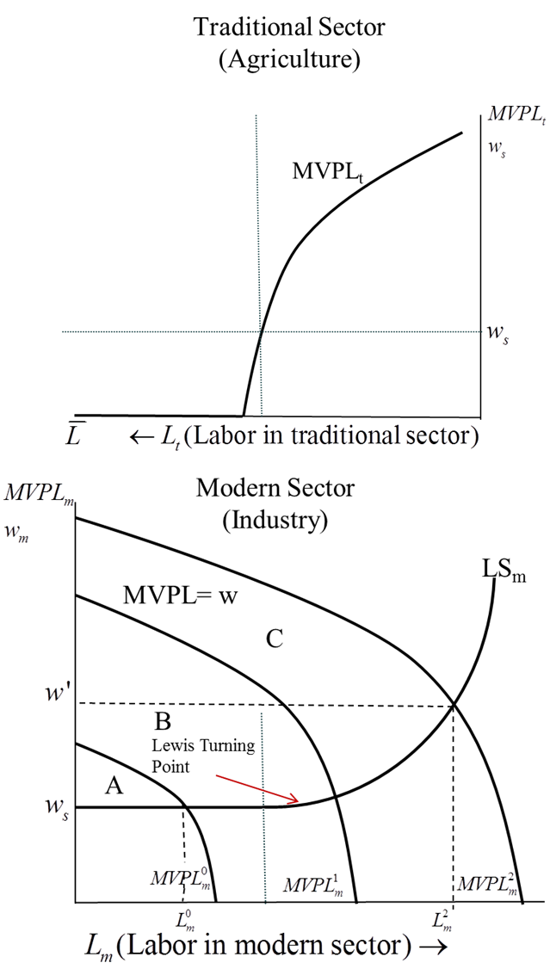
Beyond Agriculture: The Lewis Model
t: Traditional sector
m: Modern sector
MVPL_{t}, MVPL_{m} : Marginal value products
w_{s}: Subsistence wage
LS_{m}: Labor supply to modern sector
Initial labor in traditional sector

Slide 5
Criticisms and Implications of Lewis Model
Still an aggregate model
  Who moves off the farm, and who doesn’t?
Can agriculture lose labor and not output?
  TW Schultz doesn’t think so (see China box)
Ranis and Fei: Better invest in agriculture if want the modern sector to grow!
Everything depends on markets working (Chapter 9)
…and impacts of migration on rural economies (Supplemental Chapter: Migration)

Slide 6
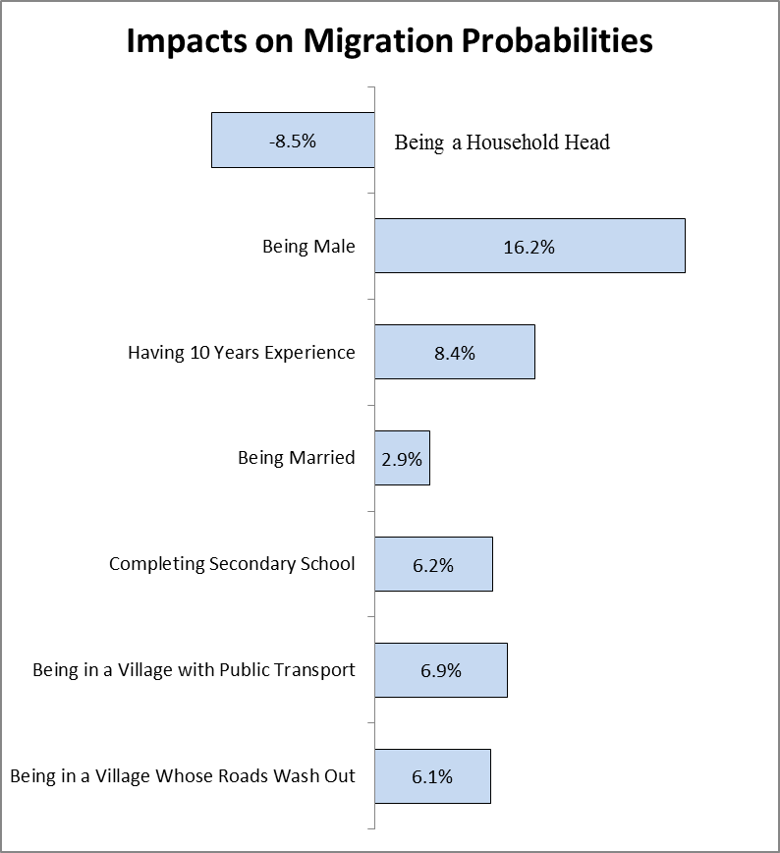
Migration is Selective
Source: Mexico National Rural Household Survey, 2008

Slide 7
Why Diversification Matters
Solving poverty: Should we focus on crop production? Staples?
  Hard to “move” poverty with staples if the staple share of rural household income is low
Impact of global food price increases on rural welfare
  Negative if food production is a small share of rural income
Diversification and welfare: scale vs. risk?
  Better get it right!

Slide 8
The Rise of CGEs for Policy Analysis
Endowments
Activities
Consumption
Consumption Markets
Output
Markets
Factors
Production
Income
Consumption
Livelihood
Factor
Markets

Slide 9
Endowments
Activities
Consumption
Consumption Markets
Output
Markets
I
C=C(I,prices)
Q=Q(F,prices)
C
U=U(C)
F
Q
Factors
Production
Income
Consumption
Livelihood
Factor
Markets

Slide 10
Endowments
Activities
Consumption
Factors
Production
Income
Consumption
Livelihood
Output
Markets
Consumption Markets
Factors
Production
Income
Consumption
Livelihood
Factor
Markets
Notes:
10

